Slide 1
Kingdom Plantae
By MbwamboJr

Slide 2
Introduction
This kingdom is made up of plants.
It is a group of eukaryotic organisms which can absorb sunlight and use its energy to make food by the process known as photosynthesis

Slide 3
General Characteristics
They are multicellular
They are eukaryotic
Their cells have cell wall made up of cellulose
They have chloroplast containing chlorophyll
They store excess carbohydrate in form of starch

Slide 4
General Characteristics
They respond very slowly to stimuli
Their body is composed of roots and shoot system
They reproduce both sexually and sexually

Slide 5
Distinctive characteristics
Their cells have cell wall made up of cellulose
They have chloroplast containing chlorophyll
They store excess carbohydrate in form of starch
Their body is composed of roots and shoot system

Slide 6
Classification of Kingdom Plantae
Division Bryophyta
Division Filicinophyta
Division Coniferophyta
Division Angiospermophyta

Slide 7
Division Bryophyta
Members include moss plants and liverworts
They are small terrestrial plants
They have no true roots, stem or leaves. Instead they have rhizoids (root-like structures), seta (stem-like structure) and thalus (leaf-like structure)
They lack specialized conducting tissues (that is, vascular tissues, xylem and phloem)

Slide 8
Division Bryophyta
They are commonly found in damp and moist places such as river banks, on trees and on rocks in humid areas
They display an alternation of generation. That is, sporophyte and gametophyte generation
They reproduce both sexually and asexually
Gametophyte generation is dominant over sporophyte generation

Slide 9
Division Bryophyta
Sporophyte generation remains attached to the gametophyte generation until it reaches maturity and depends on it for nutrients and support
The plant requires water for reproduction as sperms have to swim to reach the female gametes for fertilization to take place

Slide 10
Distinctive Characteristics
The gametophyte generation is dominant over the sporophyte generation
They have no conducting tissues (xylem and phloem)
Water is needed for fertilization to take place
The plant survive only in damp shady areas

Slide 11
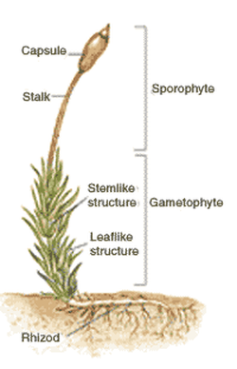
Structure of Moss Plant

Slide 12
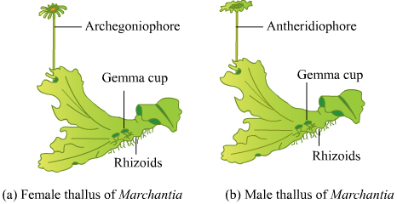
Structure of Liverwort

Slide 13
Advantages of Moss Plants
They help to decompose dead logs
They retain a lot of water. They therefore help to keep soil moist
As pioneer plants on bear ground, they help to create a suitable environment for growth and development of other plants
When they grow on land, they hold the soil particles together and help to prevent soil erosion
They are used as cushioning materials in furniture or in shipping
They provide shelter for insects and other small animals

Slide 14
Disadvantages of Moss Plants
They occur as weeds in the garden and are very difficult to get rid of
When they grow around the ponds and other small water bodies can grow into water and cover it completely causing the area to become marshy

Slide 15
Division Filicinophyta (Pteridophyta)
This division includes fern plants
They show alternation of generation. That is, gametophyte and sporophyte
The sporophyte generation is dominant over the gametophyte generation and live separately
Undergoes both sexual and asexual reproduction
They have specialized conducting tissues (xylem and phloem)

Slide 16
Division Filicinophyta (Pteridophyta)
They have true leaves called fronds with small leaflets called pinnae connected to rachis
The terminal ends of a young fronds are folded and uncoils as they grow to maturity. The young leaves are known as Fiddle Heads
They have underground stem called rhizomes

Slide 17
Division Filicinophyta (Pteridophyta)
They have spores producing structure called sporangia on the underside of the fronds. These sporangia are grouped together to form sori
It needs water for reproduction to take place since sperms must swim to reach the female gametes for fertilization to take place
They grow on moist shady areas

Slide 18
Distinctive Characteristics of Filicinophytes
The sporophyte generation is dominant over the gametophyte generation
They have simple specialized conducting tissues
They have a highly reduced underground stem called Rhizome from which the roots grow
They have large leaves called Fronds.
Some leaves have the reproductive structures grouped together forming a structure called sorus

Slide 19
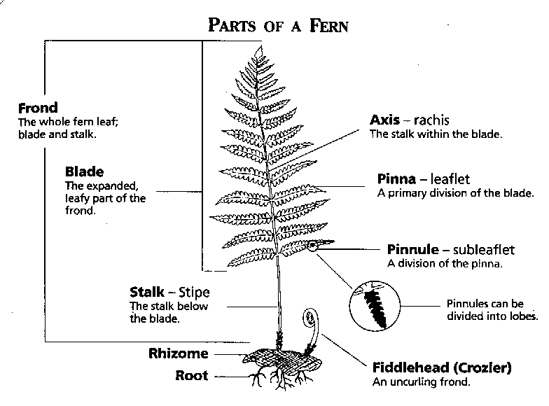
Structure of Fern Plant

Slide 20
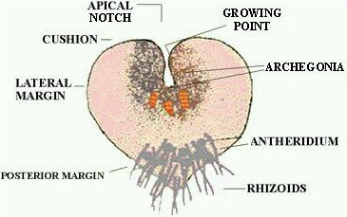
Structure of Prothallus (Gametophyte)

Slide 21
Advantages of Ferns
They are grown as ornaments in homes and offices. That is, used for decoration purposes
Serves as food for various wild animals
In some parts of the world, fiddle heads of some species are used for human consumption
They contribute in the formation of coal which is used by human as fuel
They prevent soil erosion
Some ferns are used as biological fertilizers especially in rice plantations

Slide 22
Disadvantages of Fern Plants
Ferns are found as weeds in many places. E.g. the giant water fern is one of the world’s worst aquatic weeds

Slide 23
Differences between Filicinophytes and Bryophytes
Bryophytes | Filicinophytes
The gametophyte generation is dominant over the sporophyte generation | The sporophyte generation is dominant over the gametophyte generation
They have no conducting tissues | They have simple specialized conducting tissues
They are small green plants with no true roots, leaves or stems | They have large leaves a highly reduced underground stem and true roots
They are found in damp shady places | Not exactly specified. Can be grown anywhere

